Slide 1
MGS 723: Geodynamics
Class 3: Stress

Slide 2
What is Geodynamics?
Dynamics of the Earth
The motion of bodies under the action of forces.
Figuring out the forces that shape motions and deformations on Earth!

Slide 3
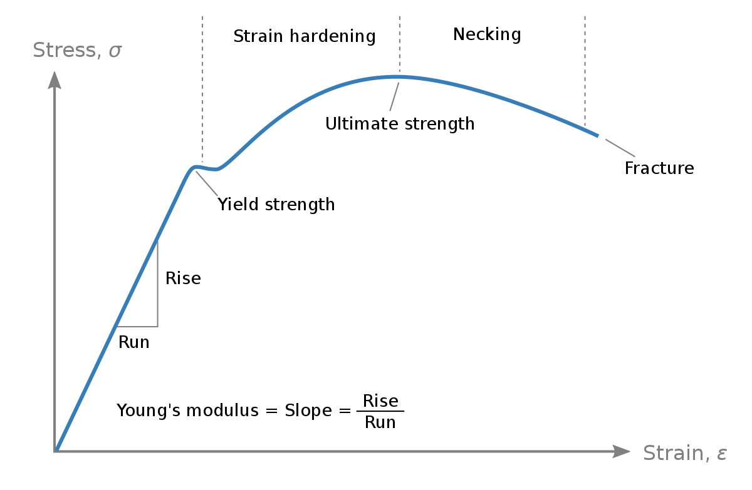
Stress produces deformation
The nature of the curve – i.e., the link between forces and deformation – depends on the material strength/properties: next class

Slide 4
Stress produces deformation
Forces
Deformation
The nature of the curve – i.e., the link between forces and deformation – depends on the material strength/properties: next class

Slide 5

To the stylus…
To: understand the stress tensor, tractions, the deviatoric stress and isostasy

Slide 6
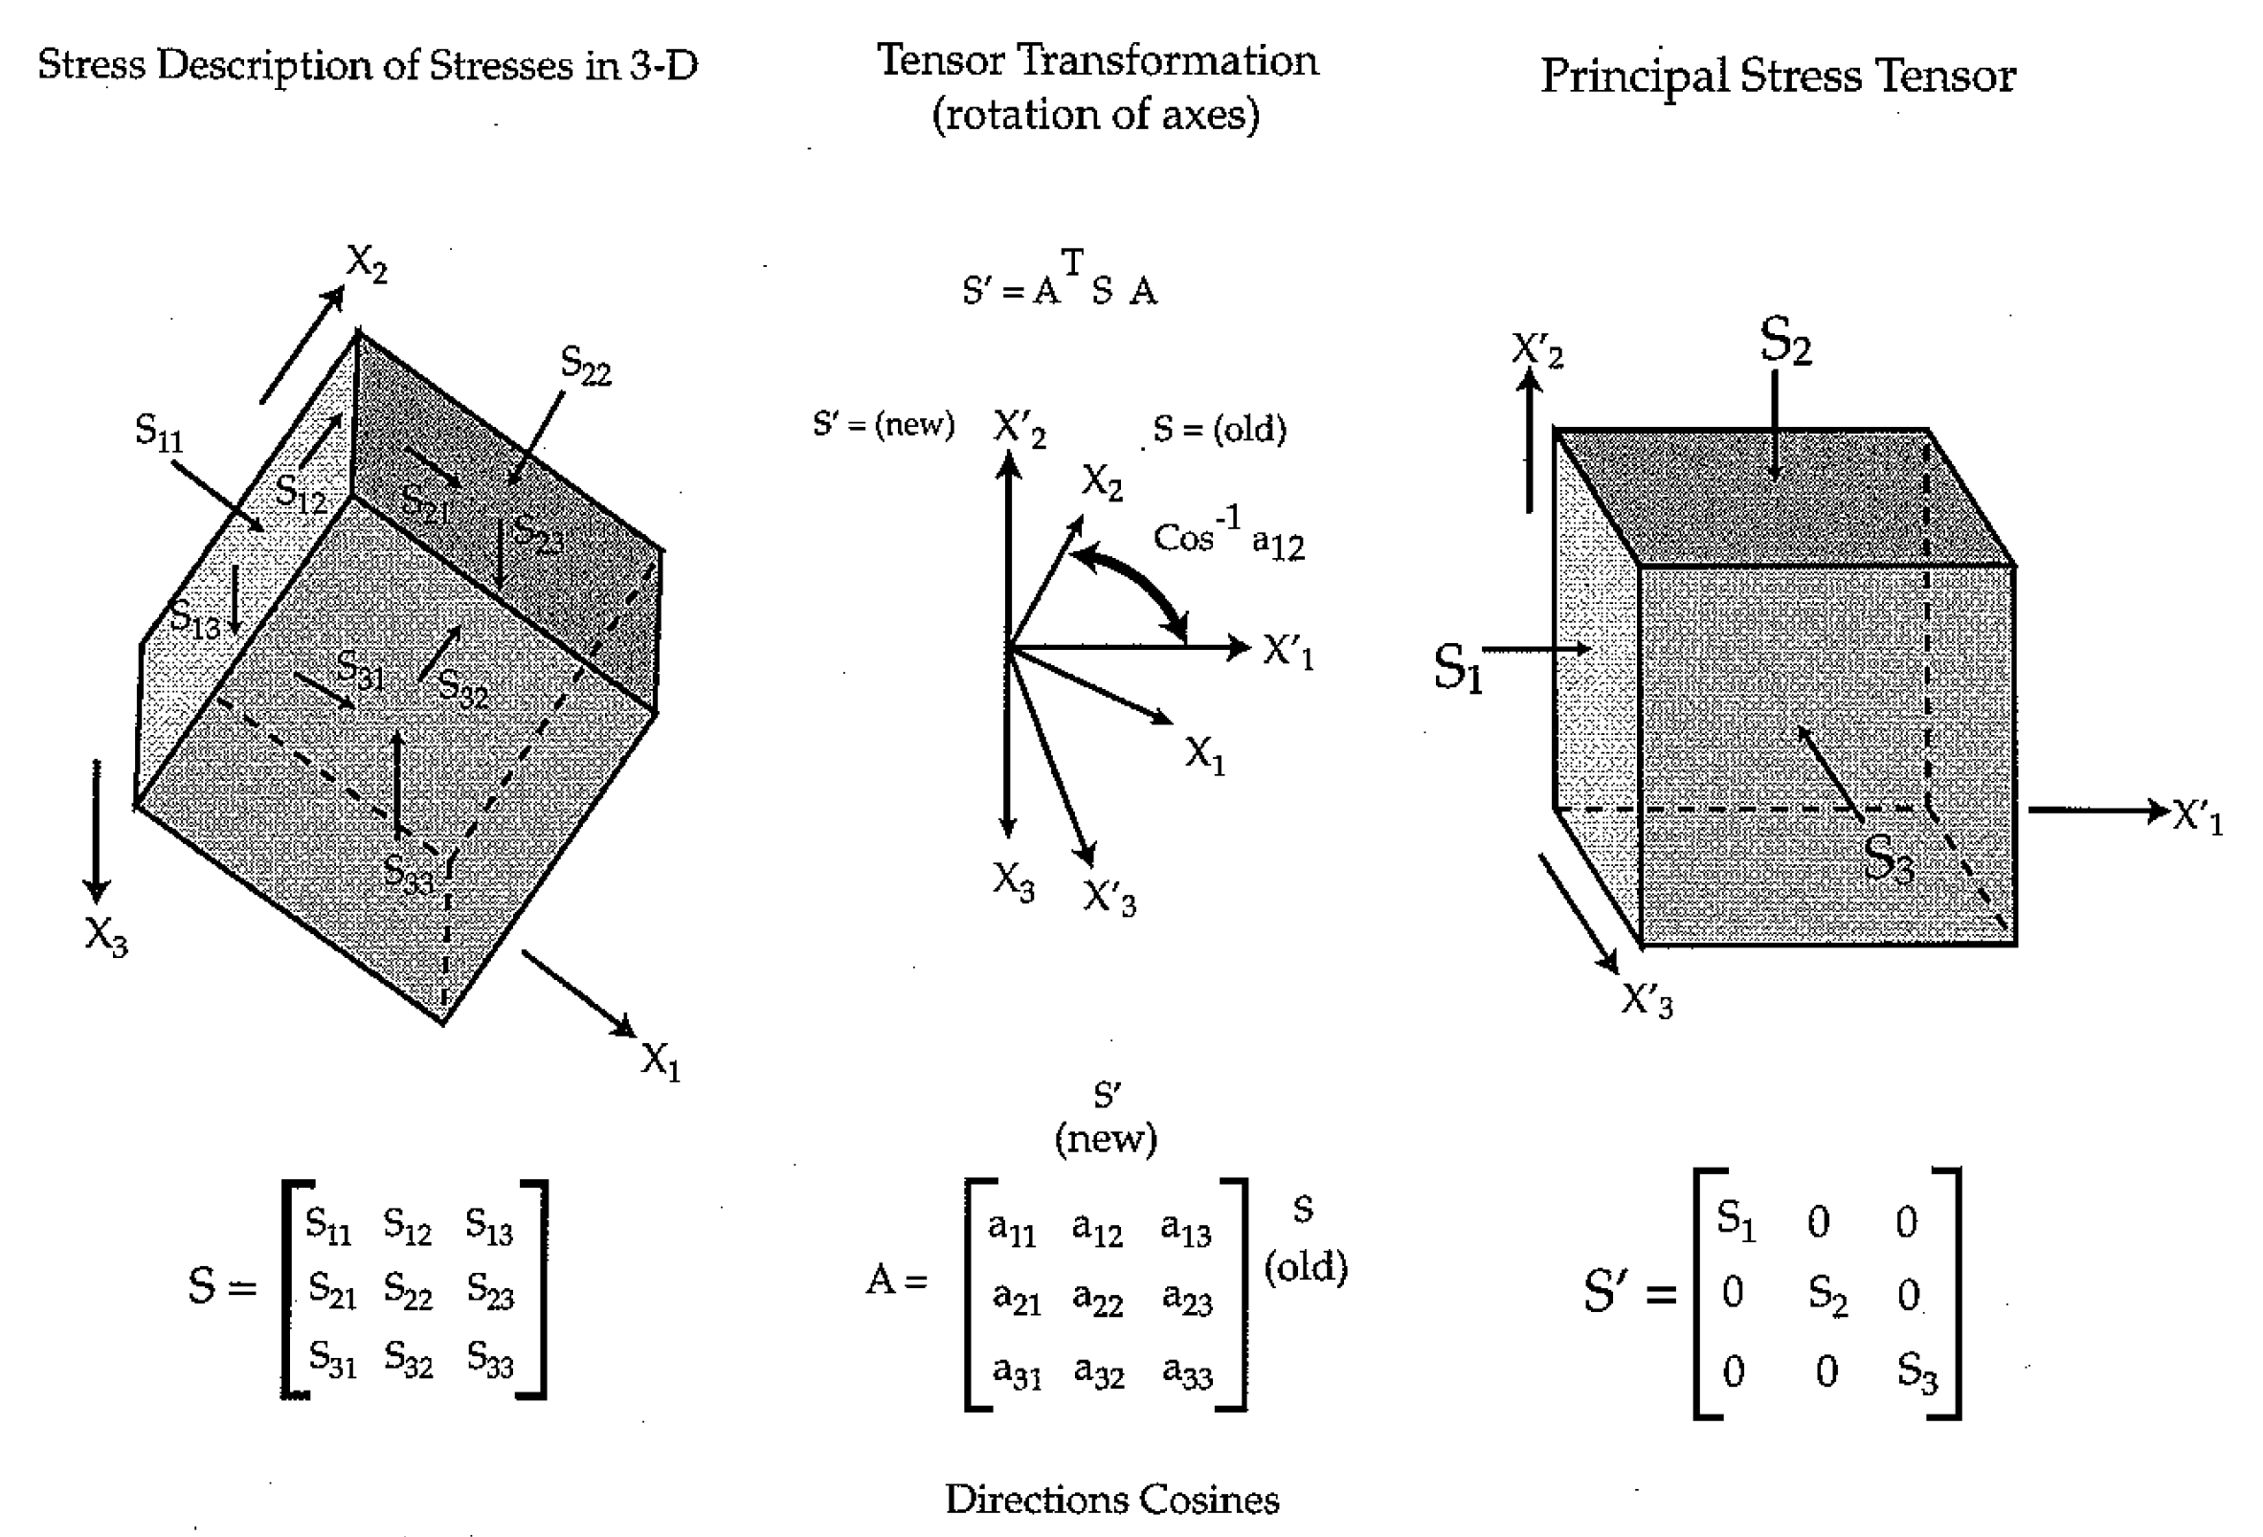
Principal stresses
Zoback and Zoback, 2002

Slide 7
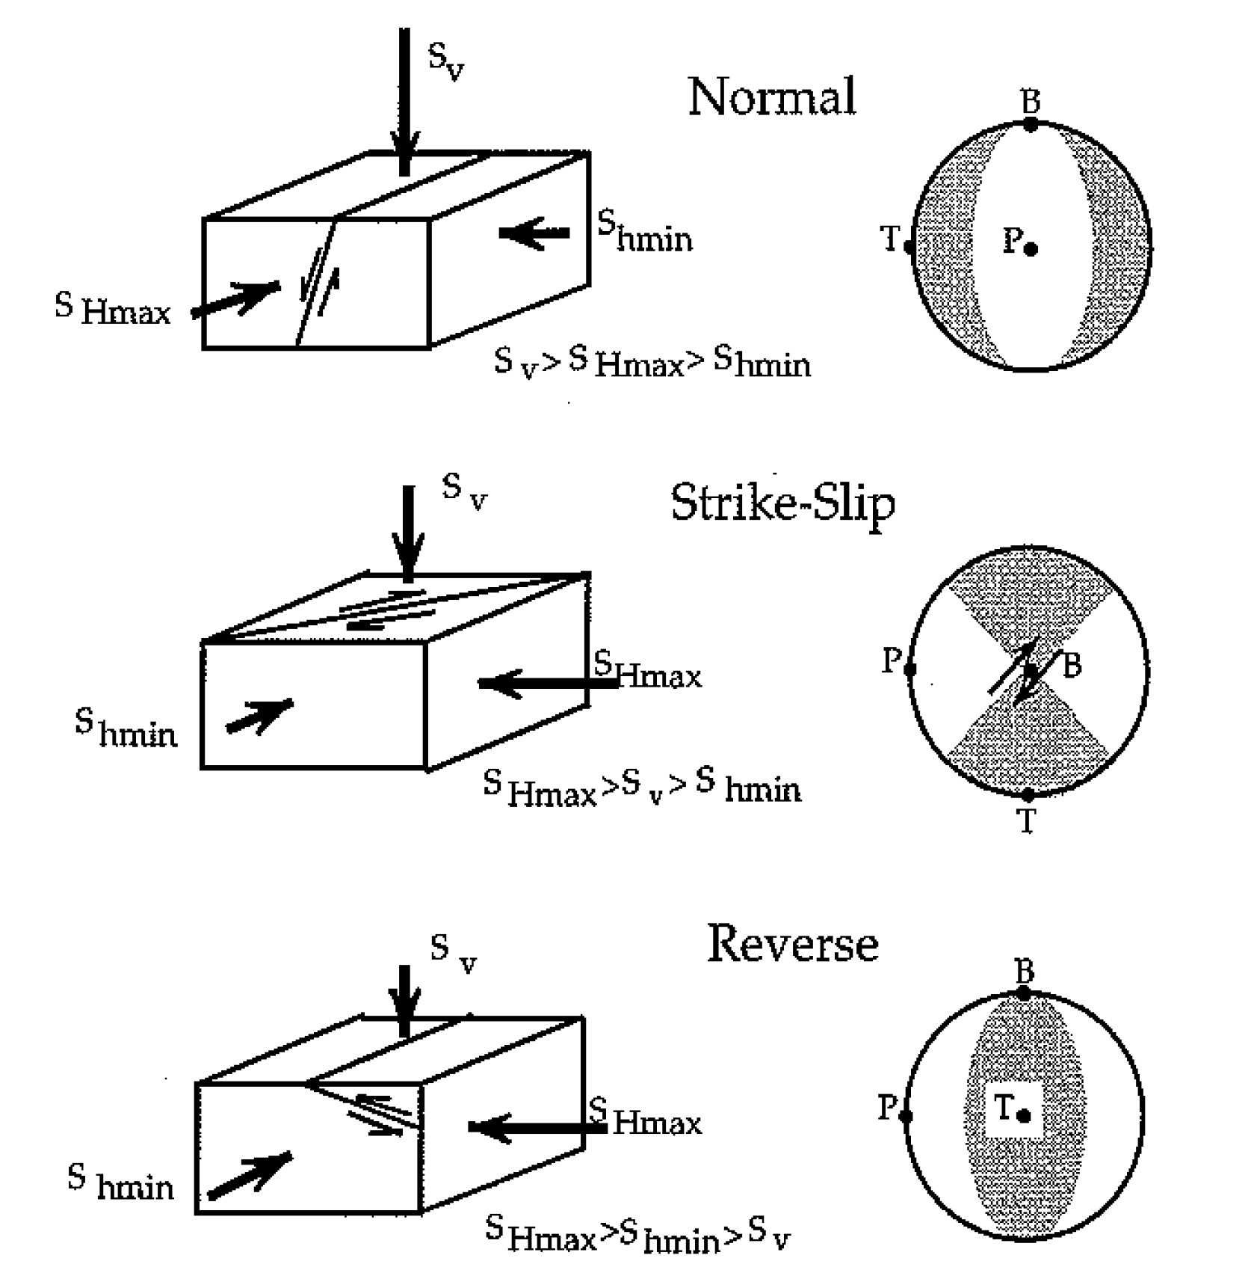
Principal stresses
On Earth, one of the principal stress directions in normal to the Earth’s free surface (as surface in contact with a fluid cannot support shear stress)

Slide 8
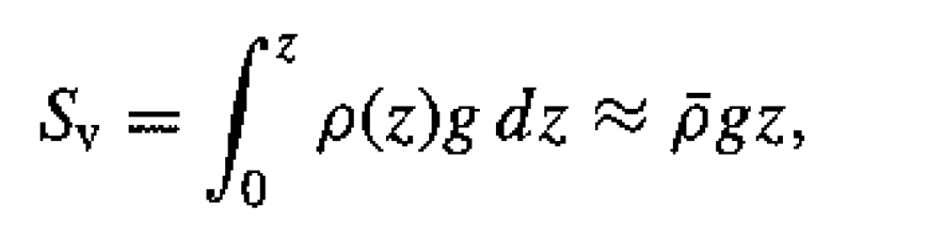
Principal stresses
On Earth, one of the principal stress directions in normal to the Earth’s free surface (as surface in contact with a fluid cannot support shear stress)
The vertical principal stress (S_{V}) is the overburden:

Slide 9
Principal stresses
On Earth, one of the principal stress directions in normal to the Earth’s free surface (as surface in contact with a fluid cannot support shear stress)
The vertical principal stress (S_{V}) is the overburden:
Anderson’s theory says that style of faulting depends on whether the other two principal stresses greater/less then S_{V}

Slide 10
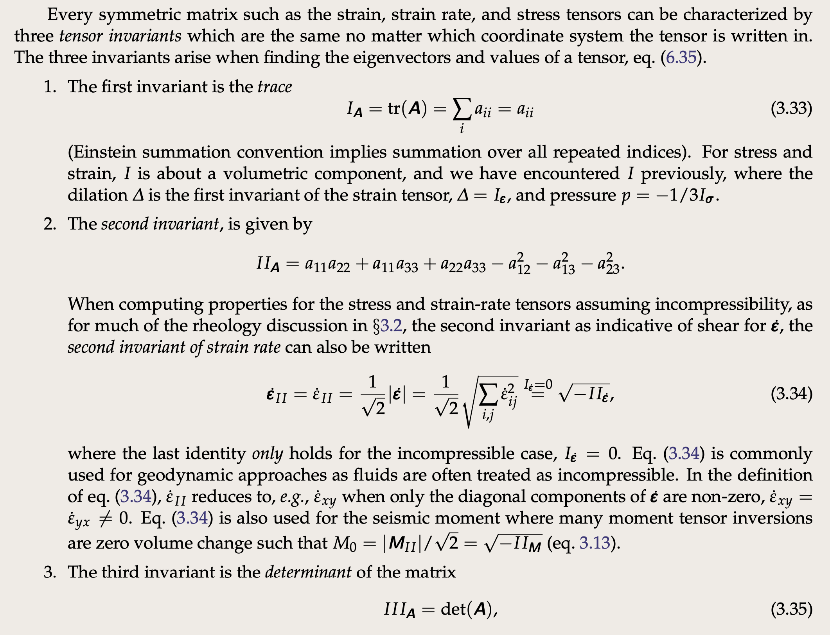
Stress invariants
Becker & Faccenna

Slide 11
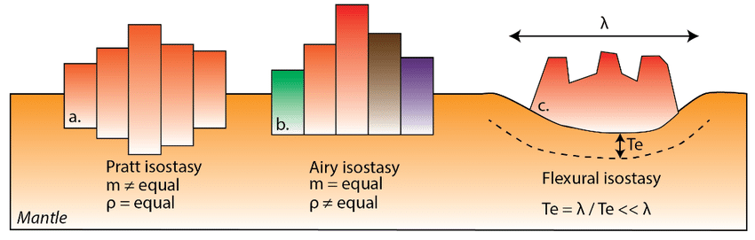
Isostasy
Pratt: Column weights balanced by variable crust thickness
Airy: Column weights balanced by variable density

Slide 12
Isostasy
Pratt: Column weights balanced by variable crust thickness
Airy: Column weights balanced by variable density
Flexural: Elastic stresses distribute the load laterally
Notes:
Te is the flexural rigidity of the lithosphere and λ the flexural wavelength.

Slide 13
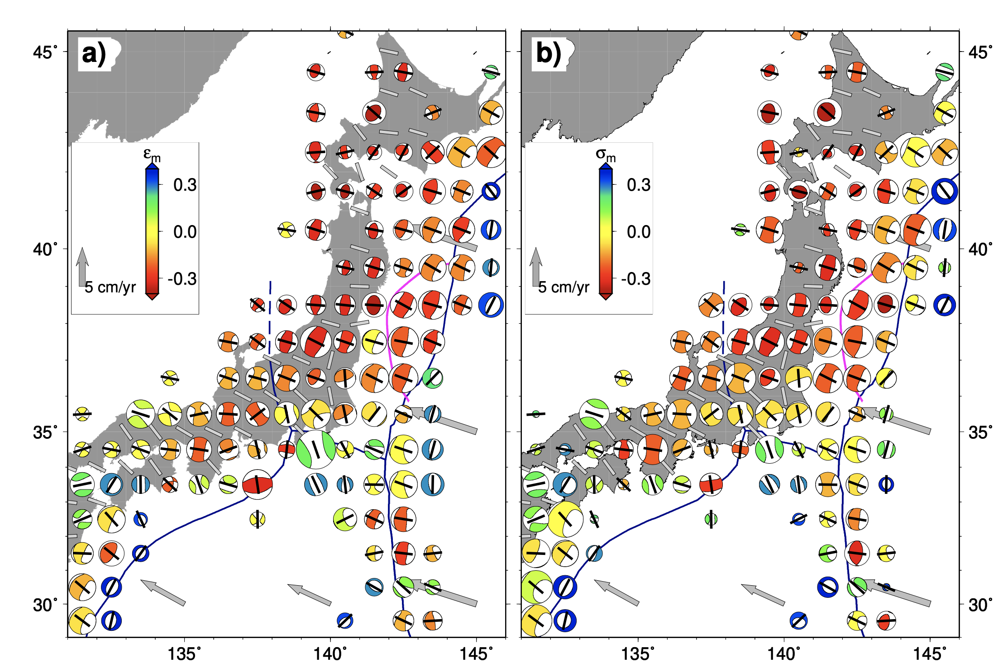
Measuring stress on Earth
Stress from earthquake mechanisms
Becker & Faccenna
strain
stress
Links between stress and strain (rheology) need to be assumed
Common: Assume maximum fault plane shear stress in direction of fault slip
Notes:
https://agupubs.onlinelibrary.wiley.com/doi/10.1029/JB092iB01p00357

Slide 14
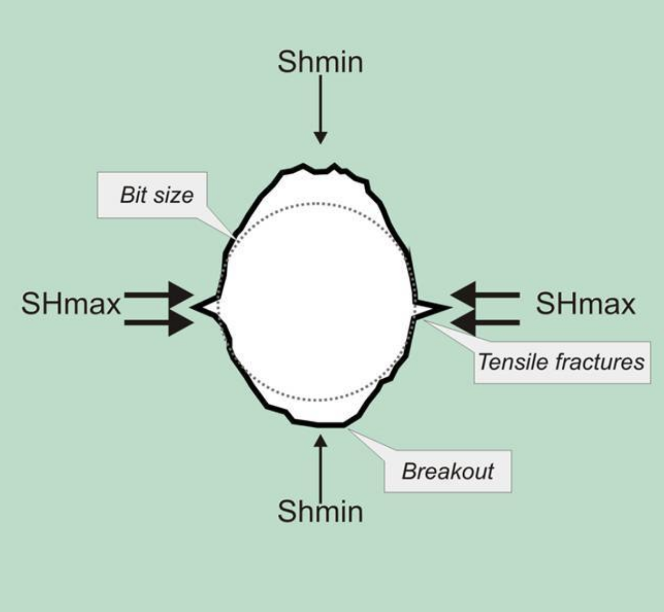
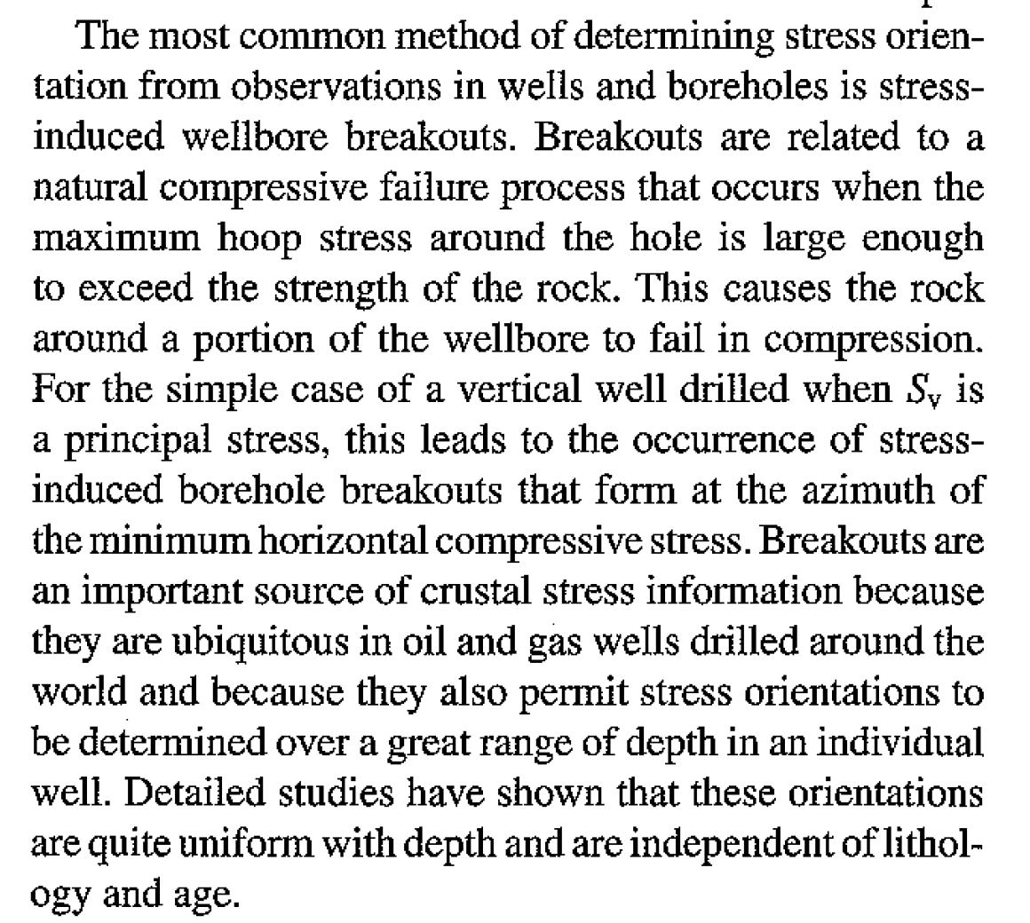
Measuring stress on Earth
Stress from borehole breakouts
Zoback and Zoback, 2002

Slide 15
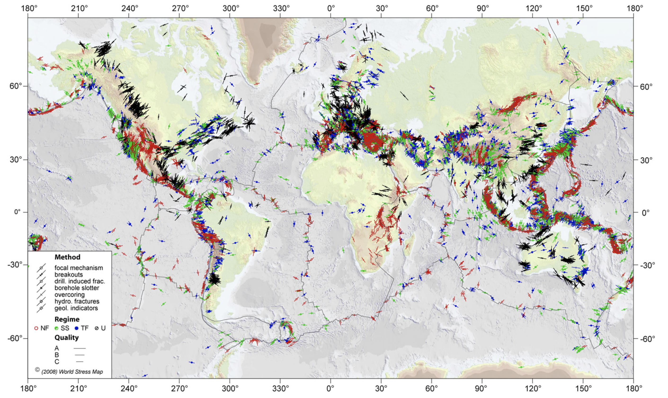
World Stress Map (Heidback et al.)
http://www.world-stress-map.org/

Slide 16
Take homes:
Stress = force/area [Pa]
A 2nd rank tensor, 6 independent components (3-D)
Traction: force per unit area vector acting on a specific plane
Principal stresses, pressure, deviatoric stress
Three stress invariants
Isostasy
Optional reading: Turcotte and Schubert, Sect. 2-3

